Slide 1
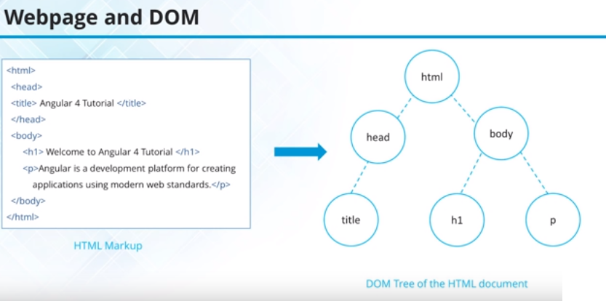

Slide 2
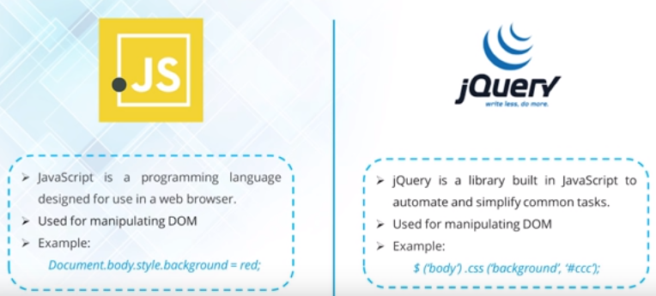

Slide 3
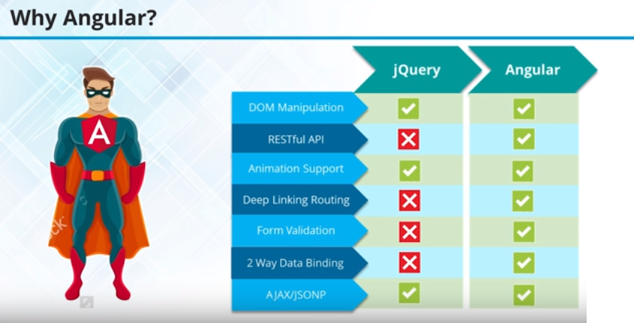

Slide 4
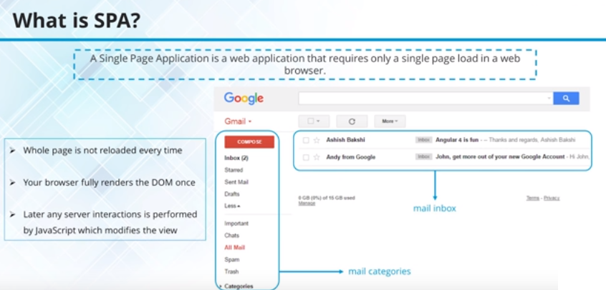

Single Page Applications

Slide 5
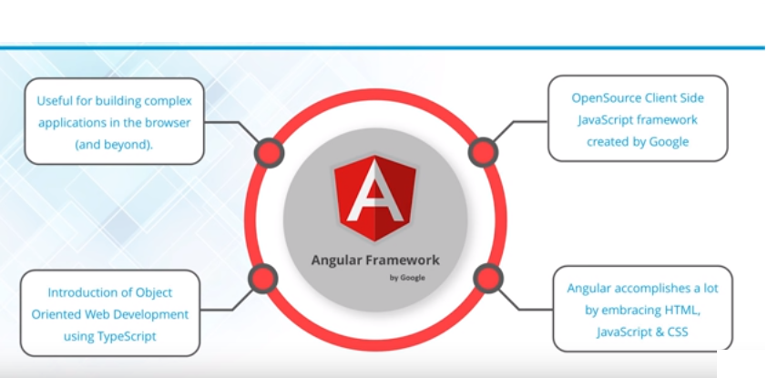
Angular Introduction

Slide 6
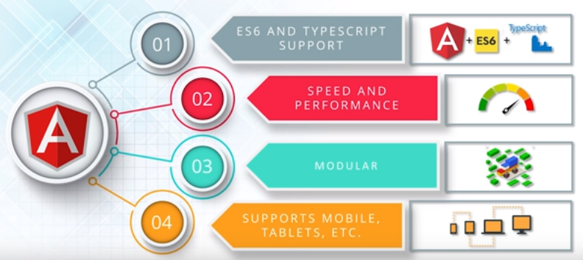
Angular Features

Slide 7
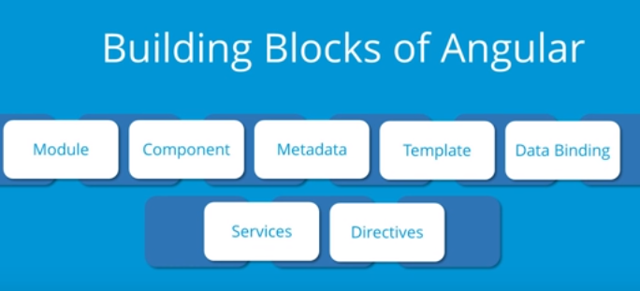

Slide 8
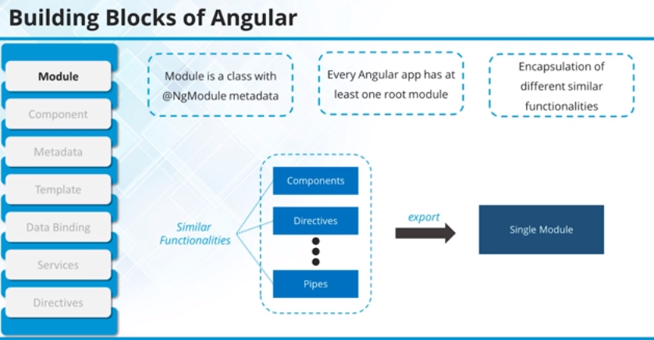

Slide 9
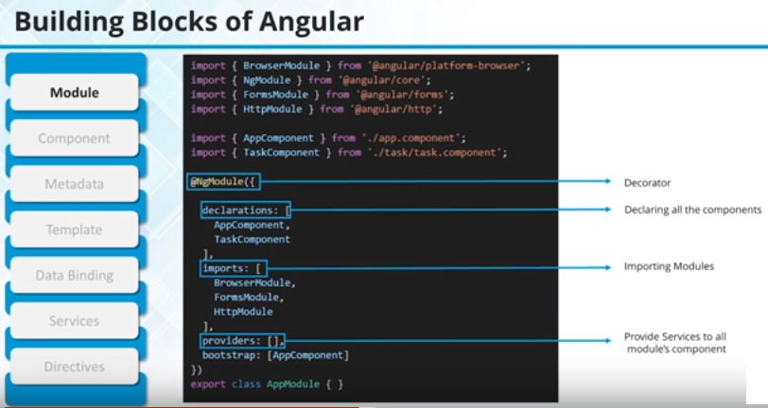

Slide 10
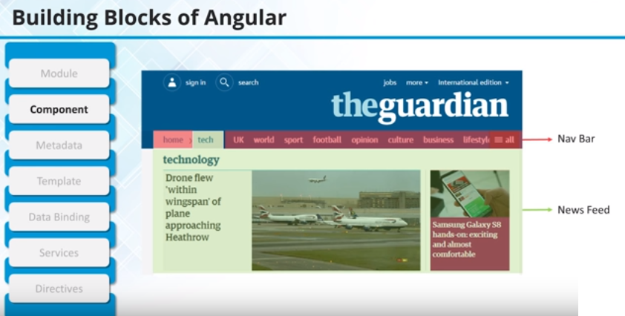
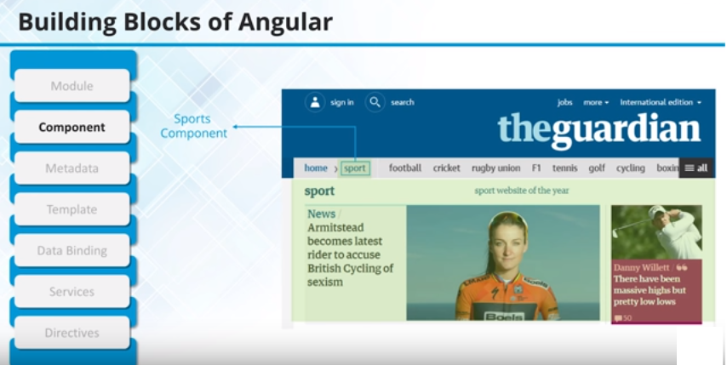

Slide 11
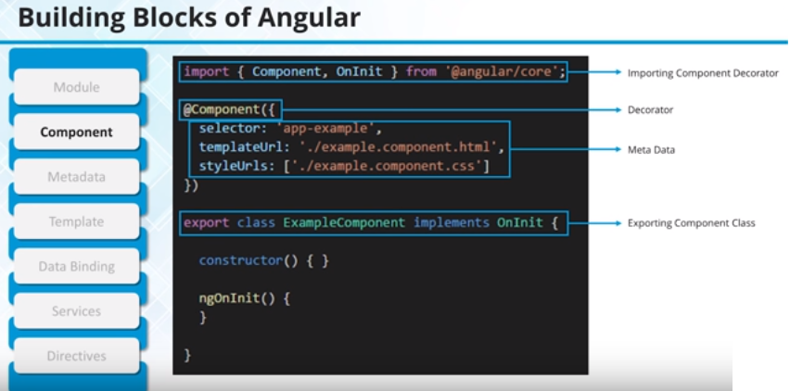

Slide 12
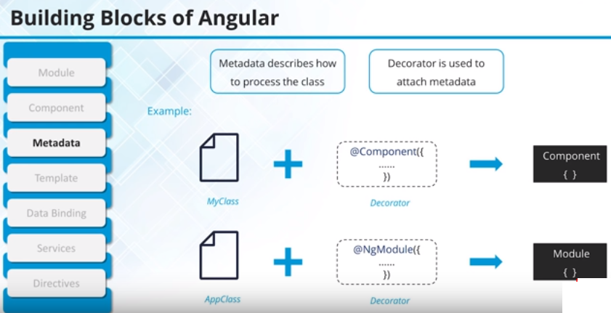
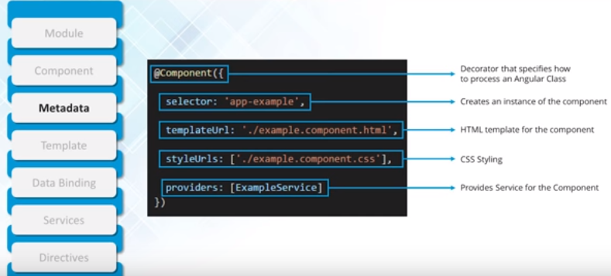

Slide 13
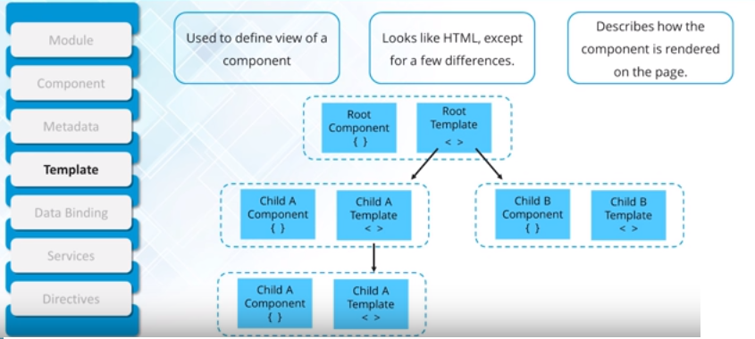
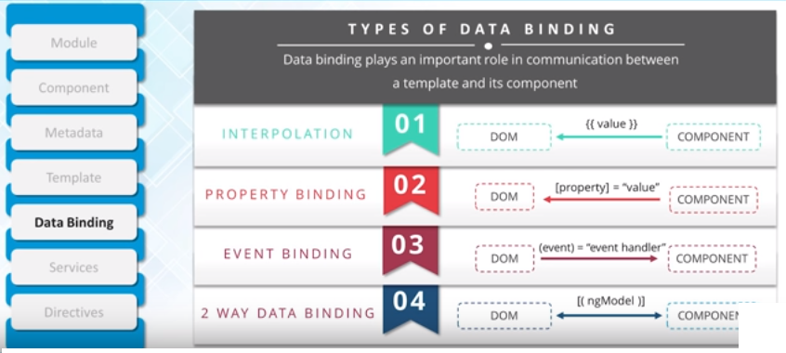

Slide 14
Angular JS
JavaScript framework for creating web and mobile single page applications.
AngularJS is an open-source, JavaScript-based, front-end web application framework for dynamic web app development. It utilizes HTML as a template language. By extending HTML attributes with directives and binding data to HTML with expressions, AngularJS creates an environment that is readable, extraordinarily expressive and quick to develop.
Angular
Angular is the blanket term used to refer to Angular 2, Angular 4 & 6 and all other versions that come after AngularJS. Both Angular 2,4,5 and 6 are open-source, TypeScript-based front-end web application platforms.

Slide 15
AngularJS
The architecture of AngularJS is based on model-view-controller (MVC) design. The model is the central component that expresses the application's behavior and manages its data, logic, and rules. The view generates an output based on the information in the model. The controller accepts input, converts it into commands and sends the commands to the model and the view.
AngularJS is written in JavaScript
Angular
In Angular 2, controllers and $scope were replaced by components and directives. Components are directives with a template.
Disadvantages of AngularJS
Not secure : Being JavaScript only framework, application written in AngularJS are not safe. Server side authentication and authorization is must to keep an application secure.
Not degradable: If the user of your application disables JavaScript, then nothing would be visible, except the basic page.

Slide 16
Difference between Typescript and JavaScript:
TypesScript is known as Object oriented programming language whereas JavaScript is a scripting language.
TypeScript has a feature known as Static typing but JavaScript does not have this feature.
TypeScript gives support for modules whereas JavaScript does not support modules.
TypeScript has Interface but JavaScript does not have Interface.
TypeScript support optional parameter function but JavaScript does not support optional parameter function.

Slide 17
The biggest difference is that TypeScript checks the types of variable at the compile time , unlike at run time in Javascript.
Demo :
Suppose you want to create an add function which takes 2 numbers and return their sum
In Javascript
function add(num1 ,num2) {
return num1 + num2
}
add(1,2) // 3 // works fine
add(1 , “Hello”) // 1Hello
no compile error. Can cause unexpected results during “Run time” of the program. You don’t want num2 to accept anything other than a number.
Typescript solves such problems by using “types” in variables declaration
In Typescript
function add(num1: number ,num2:number) {
//num1 & num2 should be only and only of type "number"
return num1 + num2
}
add(1,2) // works fine
add(1,"two") // Compile time error in typescript.Easier Testing

Slide 18
TypeScript Configuration:
TypeScript is a primary language for Angular application development. It is a superset of JavaScript with design-time support for type safety and tooling.
Browsers can't execute TypeScript directly. Typescript must be "transpiled" into JavaScript using the tsc compiler, which requires some configuration.
This page covers some aspects of TypeScript configuration and the TypeScript environment that are important to Angular developers, including details about the following files:
tsconfig.json—TypeScript compiler configuration.

Slide 19
Angular Installation:
Download Nodejs-
https://nodejs.org/en/
Steps for Angular:
npm install -g @angular/cli (npm – node package manager)
ng new my-dream-app (ng means angular)
cd my-dream-app (current directory)
ng serve
ng new:
The Angular CLI makes it easy to create an application that already work.
ng generate
Generate components, routes, services and pipes with a simple command.
ng serve
Easily test your app locally while developing.

Slide 20
Template − This is used to render the view for the application. This contains the HTML that needs to be rendered in the application. This part also includes the binding and directives.
Class − This is like a class defined in any language such as C. This contains properties and methods. This has the code which is used to support the view. It is defined in TypeScript.
The class normally has the following syntax in TypeScript.
Syntax
class classname {
Propertyname: PropertyType = Value
}
Parameters
Classname − This is the name to be given to the class.
Propertyname − This is the name to be given to the property.
PropertyType − Since TypeScript is strongly typed, you need to give a type to the property.
Value − This is the value to be given to the property.

Slide 21
export class AppComponent {
appTitle: string = 'Welcome';
}
In the example, the following things need to be noted −
We are defining a class called AppComponent.
The export keyword is used so that the component can be used in other modules in the Angular JS application.
appTitle is the name of the property.
The property is given the type of string.
The property is given a value of ‘Welcome’.

Slide 22
Template
This is the view which needs to be rendered in the application.
Syntax
Template: '
<HTML code>
class properties
'
template: '
<div>
<h1>{{appTitle}}</h1>
<div>Hi Team </div>
</div>
'
In the example, the following things need to be noted −
We are defining the HTML code which will be rendered in our application
We are also referencing the appTitle property from our class.

Slide 23
Metadata − This has the extra data defined for the Angular class. It is defined with a decorator(A Decorator is a special kind of declaration that can be attached to a class declaration, method, accessor, property, or parameter. Decorators use the form @expression)
import { Component } from '@angular/core';
@Component ({
selector: 'my-app',
template: ` <div>
<h1>{{appTitle}}</h1>
<div> Hello Team</div>
</div> `,
})
export class AppComponent {
appTitle: string = 'Welcome';
}
In the above example, the following things need to be noted −
We are using the import keyword to import the ‘Component’ decorator from the angular/core module.
We are then using the decorator to define a component.
The component has a selector called ‘my-app’. This is nothing but our custom html tag which can be used in our main html page.

Slide 24
Module in Angular refers to a place where you can group the components, directives, pipes, and services, which are related to the application.
In case you are developing a website, the header, footer, left, center and the right section become part of a module.
When you create a new project using the Angular –cli command, the ngmodule is created in the app.module.ts file by default.
Declaration
It is an array of components created. If any new component gets created, it will be imported first and the reference will be included in declarations as shown below −
declarations: [
AppComponent,
NewCmpComponent
]
Import
It is an array of modules required to be used in the application. It can also be used by the components in the Declaration array. For example, right now in the @NgModule we see the Browser Module imported
import { FormsModule } from '@angular/forms';
The import in the @NgModule will be like the following −
imports: [
BrowserModule,
FormsModule
]

Slide 25
Expressions are used to bind application data to HTML. Expressions are written inside double curly braces such as in {{ expression}}
Using numbers:
<p>Expense on Books : {{cost * quantity}} Rs</p>
Using Strings:
<p>Hello {{student.firstname + " " + student.lastname}}!</p>
Using Object:
<p>Roll No: {{student.rollno}}</p>
Using Array:
<p>Marks(Math): {{marks[3]}}</p>

Slide 26
Directives are used to extend HTML. They are special attributes starting with ng-prefix. Let us discuss the following directives −
ng-app − This directive starts an Angular Application.
ng-init − This directive initializes application data.
ng-model − This directive defines the model that is variable to be used in Angular.
ng-repeat − This directive repeats HTML elements for each item in a collection.
The ng-app directive starts an Angular Application. It defines the root element. It automatically initializes or bootstraps the application when the web page containing Angular Application is loaded. It is also used to load various Angular modules in Angular Application.

Slide 27
Angular is application for tree of components
Angular Applications are Modular
Every Angular App has at least one module: the root app
Each Application has:
Declarations:
Exports:
Imports:
Providers:
Metadata:
Tell Angular how to process a class.
Selector:
TemplateURL
Providers:
Other Metdata decorators include:
@injectable, @Input, @Output

Slide 28
Example of angular 6 element
Now let’s begin with new component
Step1 : Ng g c temp
Components are the most basic UI building block of an Angular app. An Angular app contains a tree of Angular components.
A component controls a patch of screen called a view.

Slide 29

After Angular Installation
Create Component and Overview
<app-root> Root component
Single component contains “app”.
App.component.css
App.component.html
App.component.spec.ts (logic)
Above three files provide functionality
Add !!!
See change.
App.component.ts:
title = 'FirstAppApp';
appcompoent.css:
h1 {
color:green;
}

Slide 30
Creating your own component:
Every component has html ts & css files:
Binding data to component class:
<p>
date works! {{ message }}
</p>
export class DateComponent implements OnInit {
message: string = "hello";
message: string = new Date().toDateString();
Output: date works! Sat Nov 10 2018

Slide 31
Data binding and async
export class DateComponent implements OnInit {
message: string ;
constructor() {
//Angular6 setInterval
setInterval((){
let curr= new Date();
this.message = curr;
},1000
)
}

Slide 32
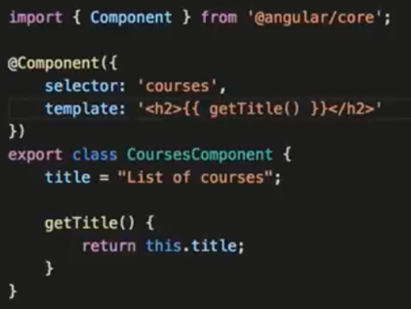
Angular Templates:

Slide 33
Template Interpolation:
{{ someNo + 1 }}
message: string ;
someNo : number = 10;
--
{{ addTwoNumbers(1,8)}}
addTwoNumbers(a: number, b:number){
return a+b;
}

Slide 34
ngFor:
<div>
<h1> {{ user.name }} </h1>
<h2> {{ user.title }} </h2>
<h3> {{ user.address }} </h3>
<!-- <h4> {{ user.phone[0] }} </h4>
<h4> {{ user.phone[1] }} </h4> -->
<h4 *ngFor="let phoneNo of user.phone">{{ phoneNo}}</h4>
</div>
this.user = {
name: 'HelloTeamm',
title: 'Developer',
address: '123456789',
phone: [
'123456789',
'158932142',
'158932142',
'123456789'
];
};

Slide 35
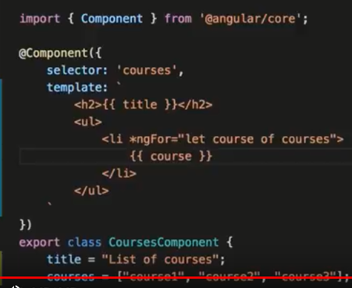
Directives:
AngularJS directives are extended HTML attributes with the prefix ng- . The ng-app directive initializes an AngularJS application. The ng-model directive binds the value of HTML controls (input, select, textarea) to application data.
Backtiks can be used to make more lines and readable.

Slide 36
Include Bootstrap:
Npm install bootstrap
and
Configure angular.json:
"styles": [
"node_modules/bootstrap/dist/css/bootstrap.min.css",
"styles.scss"
]
2: Import directly in src/style.css or src/style.scss:
@import '~bootstrap/dist/css/bootstrap.min.css';

Slide 37
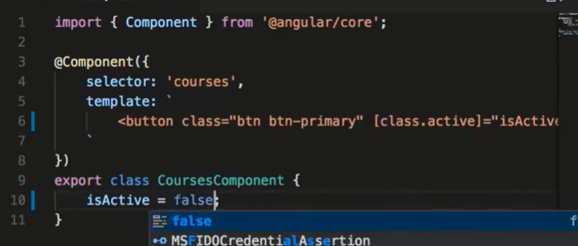
Add a Button After Bootstrap:
template: `
<button class='btn btn-primary'>Team </button>
`
Class Binding:
template: `
<button class='btn btn-primary' [class.active]="isActive">Team </button>
`

Slide 38
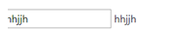
Two Way Binding:
import { Component, OnInit } from '@angular/core';
@Component({
selector: 'app-courses',
templateUrl: './courses.component.html',
styleUrls: ['./courses.component.css'] ,
template: `
<input [(ngModel)]="name" type="text"> {{ name }}
`
})
export class CoursesComponent implements OnInit {
name="";
constructor() { }
ngOnInit() {
}
}

Slide 39
Pipes:
import { Component, OnInit } from '@angular/core';
@Component({
selector: 'app-courses',
templateUrl: './courses.component.html',
styleUrls: ['./courses.component.css'] ,
template: `
{{course.title |uppercase}} <br/>
{{course.students | number}} <br/>
{{course.rating | number}} <br/>
{{course.price | currency:'AUD'}} <br/>
{{course.releaseDate | date:'shortDate' }}
`
})
export class CoursesComponent implements OnInit {
course = {
title: "Hi Team Angular Tutorial",
rating: 4.975,
students: 30124,
price: 190.25,
releaseDate: new Date(2018,4.1)
}
}

Slide 40
Angular routing:
Web applications can have different sections that correspond to different URLs, and supporting those sections programmatically is called routing.
In Simple words, As per Url, open different angular components is called routing.
URL Component
http://localhost:4200/home Home.component
http://localhost:4200/aboutus Aboutus.component
http://localhost:4200/contactus ContactUs.Component
Package that must be import:
import { Routes, RouterModule } from ‘@angular/Router’;

Slide 41
Example:
Step1 : First Create three components home,aboutus,contactus.
Step2: Configure app.module.ts as follows.
import { BrowserModule } from '@angular/platform-browser';
import { NgModule, Component } from '@angular/core';
import { FormsModule } from '@angular/forms';
import { HttpModule } from '@angular/http';
import { Routes, RouterModule } from '@angular/Router';
import { AppComponent } from './app.component';
import { AboutusComponent } from './aboutus/aboutus.component';
import { ContactusComponent } from './contactus/contactus.component';
import { HomeComponent } from './home/home.component';
const AppRoutes: Routes = [
{ path: 'about', component: AboutusComponent },
{ path: 'Home', component: HomeComponent },
{ path: 'ContactUs', component: ContactusComponent }
]
@NgModule({
declarations: [
AppComponent,
AboutusComponent,
ContactusComponent,
HomeComponent,
],
imports: [
BrowserModule,
FormsModule,
HttpModule,
RouterModule.forRoot(AppRoutes)
],
// Add provider
providers: [],
bootstrap: [AppComponent]
})
export class AppModule { }

Slide 42
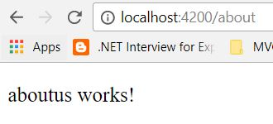
Make changes in app.component.ts as follows
import { Component } from '@angular/core';
@Component({
selector: 'app-root',
template: `
<router-outlet></router-outlet>
`,
styles: [`
p
{
background-color:silver;
font-size : 26px;
}
`],
})
export class AppComponent {
}

Slide 43
Services:
Services are written by just defining a typescript(with extension .service.ts) class
with decorator @Injectable annotation.
Step 1: First we create service using angular cli. Write following angular cli command
into integrated terminal
ng g service data
It will create two files named data.service.ts and data.service.spec.ts.
Step 2: Write the following code into service.ts
import { Injectable } from '@angular/core';
@Injectable()
export class DataService {
// Create array
hobbies = [
'dancing',
'singing',
'internet'
];
constructor() { }
// Create simple angular service method
servicemethod(){
return 'Its just a simple service method';
} }
In the above code block, an array “hobbies” and function “servicemethod” are defined which may be used by any components.

Slide 44
Step 3: Update app.module.ts (Pass the reference to newly created service and add providers)
import { DataService } from './data.service';
import { BrowserModule } from '@angular/platform-browser';
import { NgModule } from '@angular/core';
import { FormsModule } from '@angular/forms';
import { HttpModule } from '@angular/http';
import { AppComponent } from './app.component';
@NgModule({
declarations: [
AppComponent,
],
imports: [
BrowserModule,
FormsModule,
HttpModule
],
// Add provider
providers: [DataService],
bootstrap: [AppComponent]
})
export class AppModule { }

Slide 45
Step4 : Update app.component.ts as following code
import { Component } from '@angular/core';
@Component({
selector: 'app-root',
template: `
<p>hi {{data}}</p>
<li *ngFor="let h of itemsarray">
<b> {{h}} </b>
</li>
`,
styles: [`
p
{
background-color:green;
}
`],
// Don't forget to add reference of DataService
providers:[DataService]
})
export class AppComponent {
// String and array variable declartion
data;
itemsarray=[]
constructor(private dataservice: DataService) {
// use property of service
this.itemsarray = this.dataservice.hobbies;
// use method of service
this.data = this.dataservice.servicemethod();
}
}
In above code our custom service instance “dataservice” is created and using this instance we are
accessing the variable and function of angular custom service.
Next step:
Ng serve

Slide 46
Angular form control and form group:
When working with reactive forms we create instances of FormControl and FormGroup classes to create a form model.
To bind an HTML <form> tag in the template to the FormGroup instance in the component class, we use formGroup directive
To bind an HTML <input> element in the template to the FormControl instance in the component class, we use formControlName directive
formGroup and formControlName directives are provided by the ReactiveFormsModule
FormControl instance tracks the value and state of the individual html element it is associated with FormGroup instance tracks the value and state of all the form controls in it's group

Slide 47
To access the FormGroup properties use, employeeForm property in the component class. When you press DOT on the employeeForm property you can see all the available properties and methods.
To access a FormControl in a FormGroup, we can use one of the following 2 ways.
employeeForm.controls.fullName.value
employeeForm.get('fullName').value

Slide 48
Angular Forms:
There are 2 ways to create forms in Angular
Template Driven Forms
Reactive Forms (Also called Model Driven Forms)
As the name implies, Template Driven Forms are heavy on the template meaning we create the form completely in HTML. Template driven forms are easy to build and understand. They are great for creating simple forms. However, creating complex forms using template driven approach is not recommended as the HTML can get very complicated and messy. It is not easy to unit test template forms as the logic is in the HTML.
Reactive forms on the other hand allow us to build the form completely in code. This is more flexible and has many benefits over template forms. For example, it is easy to add form input elements dynamically and adjust validation at run-time based on the decisions made in code. It is also easy to unit test as most of the logic and validation is in the component class. The only downside of reactive forms is that they require more code than template forms.

Slide 49
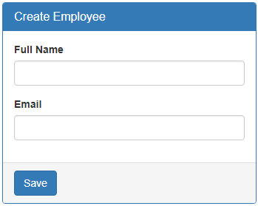

Slide 50
Creating a form group model :
Two classes that we commonly use to create a form control tree is FormGroup and FormControl. As the names imply to create a form with a group of controls, we create an instance of FormGroup class and to create each input element i.e a form control, we create an instance of FormControl class. So in the CreateEmployeeComponent (create-employee.component.ts) class
import { Component, OnInit } from '@angular/core';
// Import FormGroup and FormControl classes
import { FormGroup, FormControl } from '@angular/forms';
@Component({
selector: 'app-create-employee',
templateUrl: './create-employee.component.html',
styleUrls: ['./create-employee.component.css']
})
export class CreateEmployeeComponent implements OnInit {
// This FormGroup contains fullName and Email form controls
employeeForm: FormGroup;
constructor() { }
// Initialise the FormGroup with the 2 FormControls we need.
// ngOnInit ensures the FormGroup and it's form controls are
// created when the component is initialised
ngOnInit() {
this.employeeForm = new FormGroup({
fullName: new FormControl(),
email: new FormControl()
});
}
}

Slide 51
Binding the FormGroup model and the view : Copy and paste the following HTML in create-employee.component.html file. This is pure HTML. There is no Angular code in this HTML. We have a <form> element and 2 text input elements (for fullName and email)
<form class="form-horizontal">
<div class="panel panel-primary">
<div class="panel-heading">
<h3 class="panel-title">Create Employee</h3>
</div>
<div class="panel-body">
<div class="form-group">
<label class="col-sm-2 control-label" for="fullName">Full Name</label>
<div class="col-sm-8">
<input id="fullName" type="text" class="form-control">
</div>
</div>
<div class="form-group">
<label class="col-sm-2 control-label" for="email">Email</label>
<div class="col-sm-8">
<input id="email" type="text" class="form-control">
</div>
</div>
</div>
<div class="panel-footer">
<button class="btn btn-primary" type="submit">Save</button>
</div>
</div>
</form>

Slide 52
Now we need to bind the view template to the form group model we created in the component class. For this we make use of the following 2 directives provided by Angular ReactiveFroms module.
formGroup
formControlName
Here is the modified HTML. Notice the use of formGroup and formControlName directives in the <form> element and the 2 input elements.
<form class="form-horizontal" [formGroup]="employeeForm">
<div class="panel panel-primary">
<div class="panel-heading">
<h3 class="panel-title">Create Employee</h3>
</div>
<div class="panel-body">
<div class="form-group">
<label class="col-sm-2 control-label" for="fullName">Full Name</label>
<div class="col-sm-8">
<input id="fullName" type="text" class="form-control" formControlName="fullName">
</div>
</div>
<div class="form-group">
<label class="col-sm-2 control-label" for="email">Email</label>
<div class="col-sm-8">
<input id="email" type="text" class="form-control" formControlName="email“>
</div>
</div>
</div>
<div class="panel-footer">
<button class="btn btn-primary" type="submit">Save</button>
</div>
</div>
</form>

Slide 53
The 2 directives (formGroup and formControlName) are in ReactiveForms module, but we have not yet imported it in our root module. So in the AppModule (app.module.ts file), import ReactiveFormsModule and include it in the imports array. import { ReactiveFormsModule } from '@angular/forms';
Accessing form data : To access form data, bind to the ngSubmit event on the <form> element. This ngSubmit event is raised when a button with input type=submit is clicked.
<form class="form-horizontal" [formGroup]="employeeForm" (ngSubmit)="onSubmit()">
In the component class (create-employee.component.ts), include onSubmit() method as shown below.
onSubmit(): void {
console.log(this.employeeForm.value);
}
At this point, fill out the form and click Save button. Notice, the Formgroup value property is logged to the console. The value property of the FormGroup contains each form control name and it's associated value.

Slide 54
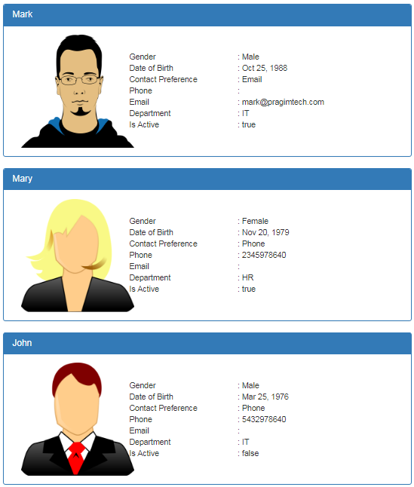
Read Operation in Angular

Slide 55
At the moment, we do not have Employee model. First, let's create the Employee model.
Creating Employee model :
Expand the "src" folder
Right click on the "App" folder, and select "New Folder" from the context menu
Name the folder "models". We will place all our models in this folder
Now add a new file in the "models" folder
Name it "employee.model.ts"
Copy and paste the following code in it
export class Employee {
id: number;
name: string;
gender: string;
email?: string;
phoneNumber?: number;
contactPreference: string;
dateOfBirth: Date;
department: string;
isActive: boolean;
photoPath?: string;
}
Next, create a component to display the list of employees. Name it ListEmployeesComponent.
ng g c employees/listEmployees --spec false --flat true
The above command not only creates the ListEmployeesComponent, it also updates the AppModule.

Slide 56
list-employees.component.ts
import { Component, OnInit } from '@angular/core';
// import Employee Model
import { Employee } from '../models/employee.model';
@Component({
selector: 'app-list-employees',
templateUrl: './list-employees.component.html',
styleUrls: ['./list-employees.component.css']
})
export class ListEmployeesComponent implements OnInit {
//
// how to retrieve this employees data from a database table
employees: Employee[] = [
{
id: 1,
name: 'Mark',
gender: 'Male',
contactPreference: 'Email',
email: 'mark@pragimtech.com',
dateOfBirth: new Date('10/25/1988'),
department: 'IT',
isActive: true,
photoPath: 'assets/images/mark.png'
},
constructor() { }
ngOnInit() {
}
}
{
id: 2,
name: 'Mary',
gender: 'Female',
contactPreference: 'Phone',
phoneNumber: 2345978640,
dateOfBirth: new Date('11/20/1979'),
department: 'HR',
isActive: true,
photoPath: 'assets/images/mary.png'
},
{
id: 3,
name: 'John',
gender: 'Male',
contactPreference: 'Phone',
phoneNumber: 5432978640,
dateOfBirth: new Date('3/25/1976'),
department: 'IT',
isActive: false,
photoPath: 'assets/images/john.png'
},
];

Slide 57
Changes in list-employees.component.html : Replace the existing HTML, with the following HTML. Notice we are using Bootstrap for styling.
<div class="panel panel-primary" *ngFor="let employee of employees">
<div class="panel-heading">
<h3 class="panel-title">{{employee.name}}</h3>
</div>
<div class="panel-body">
<div class="col-xs-10">
<div class="row vertical-align">
<div class="col-xs-4">
<img class="imageClass" [src]="employee.photoPath" />
</div>
<div class="col-xs-8">
<div class="row">
<div class="col-xs-6">
Gender
</div>
<div class="col-xs-6">
: {{employee.gender}}
</div>
</div>
<div class="row">
<div class="col-xs-6">
Date of Birth
</div>
<div class="col-xs-6">
: {{employee.dateOfBirth | date}}
</div>
</div>
<div class="row">
<div class="col-xs-6">
Contact Preference
</div>
<div class="col-xs-6">
: {{employee.contactPreference}}
</div>
</div>
</div>
</div>
</div>
</div>
</div>

Slide 58
Changes in list-employees.component.css : Include the following CSS classes
.imageClass{
width:200px;
height:200px;
}
.vertical-align{
display: flex;
align-items: center;
}
Changes in app.component.html : Include the ListEmployeesComponent selector (app-list-employees) as a directive in the root component (app.component.html)
<div class="container">
<app-list-employees></app-list-employees>
</div>
it also launches your default browser and displays the list of employees as expected.
ng serve -o

Slide 59
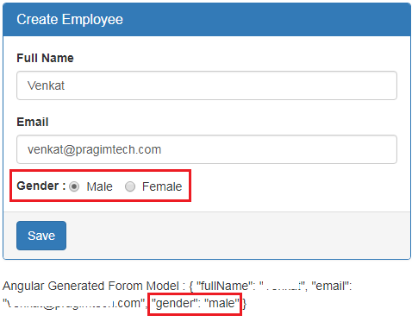
Bootstrap radio buttons in Angular

Slide 60
create-employee.component.html file
<div class="form-group">
<label>Gender</label>
<div class="form-control">
<label class="radio-inline">
<input type="radio" name="gender" value="male" [(ngModel)]="gender">
Male
</label>
<label class="radio-inline">
<input type="radio" name="gender" value="female" [(ngModel)]="gender">
Female
</label>
</div>
</div>
CodeExplanation: The name attribute is required to group the radio buttons as one unit and make the selection mutually exclusive. Make sure both the radio buttons have the same value for the "name" attribute. Otherwise the radio button selection won't be mutually exclusive.
It is also important that you set the "value" attribute for each radio button. This value is posted to the server when the form is submitted.

Slide 61
create-employee.component.html
<form #employeeForm="ngForm" (ngSubmit)="saveEmployee(employeeForm)">
<div class="panel panel-primary">
<div class="panel-heading">
<h3 class="panel-title">Create Employee</h3>
</div>
<div class="panel-body">
<div class="form-group">
<label for="fullName">Full Name</label>
<input id="fullName" type="text" class="form-control" name="fullName"
[(ngModel)]="fullName">
</div>
<div class="form-group">
<label for="email">Email</label>
<input id="email" type="text" class="form-control" name="email"
[(ngModel)]="email">
</div>
<div class="form-group">
<label for="phoneNumber">Phone Number</label>
<input id="phoneNumber" type="text" class="form-control" name="phoneNumber"
[(ngModel)]="phoneNumber">
</div>

Slide 62
<div class="form-group">
<label>Contact Preference</label>
<div class="form-control">
<label class="radio-inline">
<input type="radio" name="contactPreference" value="email"
[(ngModel)]="contactPreference">
Email
</label>
<label class="radio-inline">
<input type="radio" name="contactPreference" value="phone"
[(ngModel)]="contactPreference">
Phone
</label>
</div>
</div>
<div class="form-group">
<label>Gender</label>
<div class="form-control">
<label class="radio-inline">
<input type="radio" name="gender" value="male" [(ngModel)]="gender">
Male
</label>
<label class="radio-inline">
<input type="radio" name="gender" value="female" [(ngModel)]="gender">
Female
</label>
</div>
</div>
</div>
<div class="panel-footer">
<button class="btn btn-primary" type="submit">Save</button>
</div>
</div>
</form>

